Slide 1
Benazir Bhutto Shaheed University Lyari, Karachi
Department of Computing Science & Information Technology

Slide 2
Object Oriented Programming (CS and IT-321) 2nd Semester
Object Oriented Design Concepts

Slide 3
Program Development
The creation of software involves four basic activities:
establishing the requirements
creating a design
implementing the code
testing the implementation
These activities are not strictly linear – they overlap and interact

Slide 4
Requirements
Software requirements specify the tasks that a program must accomplish
what to do, not how to do it
Often an initial set of requirements is provided, but they should be critiqued and expanded
It is difficult to establish detailed, unambiguous, and complete requirements
Careful attention to the requirements can save significant time and expense in the overall project

Slide 5
Design
A software design specifies how a program will accomplish its requirements
That is, a software design determines:
how the solution can be broken down into manageable pieces
what each piece will do
An object-oriented design determines which classes and objects are needed, and specifies how they will interact
Low level design details include how individual methods will accomplish their tasks

Slide 6
Implementation
Implementation is the process of translating a design into source code
Novice programmers often think that writing code is the heart of software development, but actually it should be the least creative step
Almost all important decisions are made during requirements and design stages
Implementation should focus on coding details, including style guidelines and documentation

Slide 7
Testing
Testing attempts to ensure that the program will solve the intended problem under all the constraints specified in the requirements
A program should be thoroughly tested with the goal of finding errors
Debugging is the process of determining the cause of a problem and fixing it
We revisit the details of the testing process later in this chapter

Slide 8
Object Oriented Programming Problem Solving

Slide 9
Definition
It is a systematic approach to find and implement the solution of a problem.

Slide 10
Steps in Problem Solving
Problem Definition
Problem Analysis
Design
Coding
Testing
Maintenance

Slide 11
Problem Definition
To solve a problem, the first step is to identify and define the problem.
The problem must be stated clearly, accurately and precisely.
For example: Find largest of three numbers

Slide 12
Problem Analysis
The problem analysis helps in designing and coding for that particular problem.
Input specifications
The number of inputs and what forms the input are available
Output specifications
The number of outputs and what forms the output should be displayed.
E-x input – a,b,c output - c

Slide 13
Designing a program
1. Algorithms
2. Flowcharts
Algorithm - step by step procedure of solving a problem
Flowcharts – It is the graphical representation of the algorithm.

Slide 14
Coding
Writing instructions in a particular language to solve a problem.

Slide 15
Testing a Program
After writing a program, programmer needs to test the program for completeness, correctness, reliability and maintainability.
Unit testing
Program Testing
Verification Testing
Validation Testing

Slide 16
Maintaining the program
It means periodic review of the programs and modifications based on user requirements.

Slide 17
Algorithm

Slide 18
Algorithms
The word algorithm comes from the name of a Persian mathematician Abu Ja’far Mohammed ibn-i Musa al Khowarizmi.
In computer science, this word refers to a special method useable by a computer for solution of a problem. The statement of the problem specifies in general terms the desired input/output relationship.
For example, sorting a given sequence of numbers into nondecreasing order provides fertile ground for introducing many standard design techniques and analysis tools.

Slide 19
Cont.
A sequential solution of any program/project that written in human language, called algorithm.
Algorithm is first step of the solution process, after the analysis of problem, programmer writes the algorithm of that problem.
An algorithm should always have a clear stopping point.

Slide 20
Flowcharts
Graphically depict the logical steps to carry out a task and show how the steps relate to each other.

Slide 21
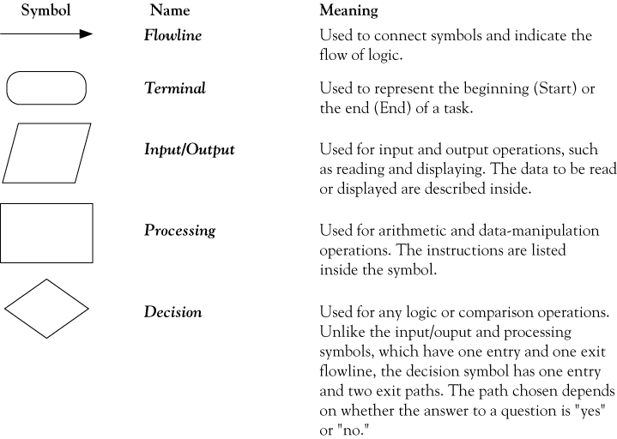
Flowchart symbols

Slide 22
Pseudocode
Uses English-like phrases to outline the task.
pseudocode is a method of developing an algorithm. Programmers can use informal simple language to write a pseudocode and there is no strict syntax to follow

Slide 23
Pseudocode example
Determine the proper number of stamps for a
letter
Read Sheets (input)
Set the number of stamps to Sheets / 5 (processing)
Round the number of stamps up to the next
whole number (processing)
Display the number of stamps (output)

Slide 24
Coding
Coding is the translation of an algorithm or flowchart into a suitable computer language c,c++,java

Slide 25
Testing and Debugging
To achieve the required output, the program that is written in coding must be tested
,compiled and executed.
Types of errors syntax error semantic error Run-time error

Slide 26
Debugging
It is the process of identifying and correcting the bugs.

Slide 27
Maintenance
Periodic review of the program and modifications based on their user requirements.

